Slide 1


https://blog.wish.com
Summer Sales Insights: Performance Analytics and Strategic Enhancements for Wish.com Apparel

Slide 2

Table Of Contents
1
7
Ratings and units sold analysis
Dataset overview
2
Generated variables
& Dataset modifications
Impact of Ad Boosts on Sales
8
3
9
General statistics
Merchant performance insights
4
10
Shipping options & Sales impact
Product features analysis
5
Top performing categories in sales
Banner & Urgency status on sales impact
11
6
Ratings and price factor analysis
Human sensitiveness to price drops
12

Slide 3
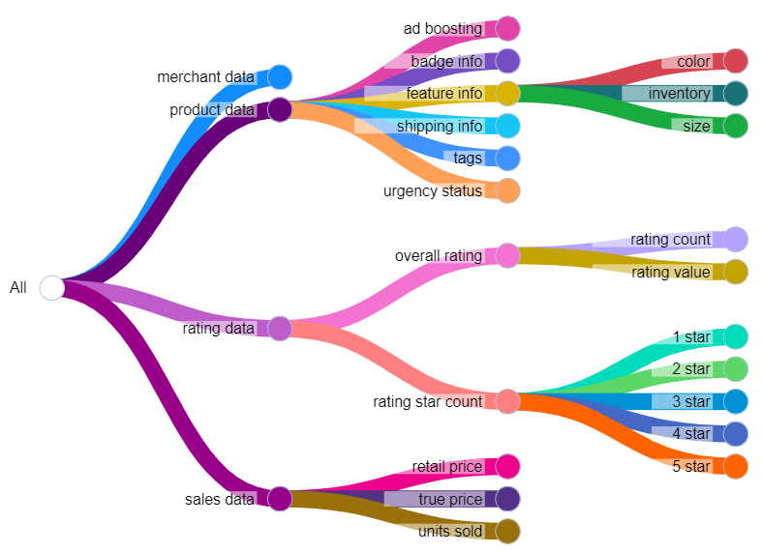
01
Dataset overview
there are two possible explanations

Slide 4
02
Generated variables & Dataset modifications
This dataset contains product listings as well as sales performance, which you would not find in other datasets. With this, you can finally start to look for correlations and patterns regarding the success of a product and the various components.
The index, crawl_month, product_picture, product_url, merchant_profile_picture columns are dropped since they are not relevant to the analysis
Currency_buyer and theme columns are deleted because they have only 1 value (EUR and Summer respectively), which gives no insights into the dataset. Shipping_option_name, urgency_text, origin_country also removed from analysis as most products have the same shipping option and urgency message (quantity limited and origin country (China)
Uses_ad_boosts, badge_local_product, badge_product_quality, badge_fast_shipping, shipping_is_express, has_urgency_banner, merchant_has_profile_picture is turned into True/False datatype instead of 0 and 1
Merchant name and merchant title are nearly similar. Additionally, since there are no two merchants of different id that have the same title, the merchant title is unique. We can remove the columns merchant_id and merchant_name
Additionally, title_orig is also unique for product_id, so we can also remove the product_id and title columns
merchant_positive_review_percent is added to the dataset, derived from the merchant_info_subtitle column
Tags column generate 3 columns: tags_count, popular_tags_count and unpopular_tags_count. Popularity is determined by how often the tag occurs in all products in the dataset. If a tag occurs in at least 10 products, it is popular tag, otherwise it is unpopular

Slide 5

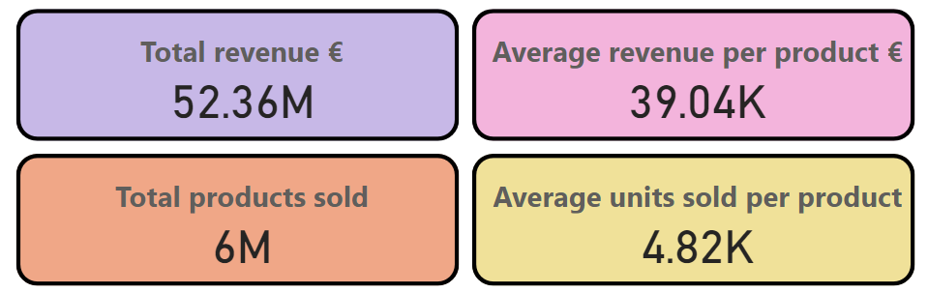

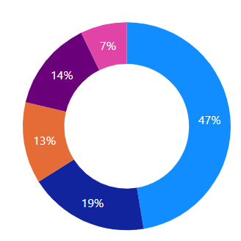
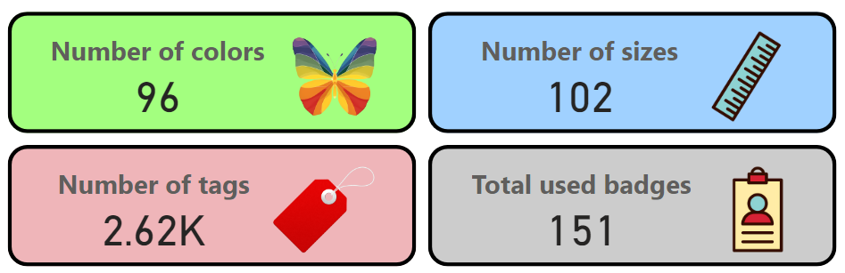
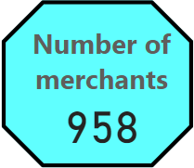
03
General statistics

Slide 6
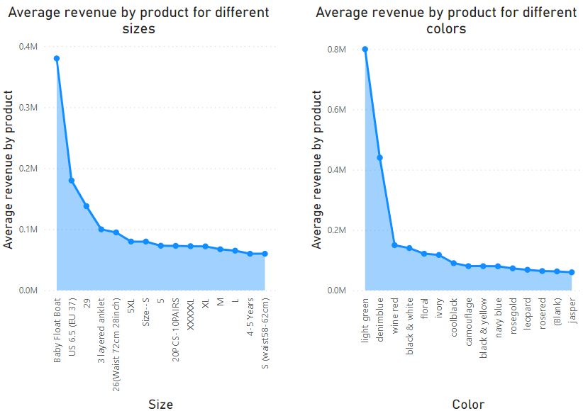
04
Product features analysis
It appears that products using ad boosting actually have lower average units sold and revenue as compared to those without ad boosting. This can be a surprising finding, but there are two possible explanations

Slide 7
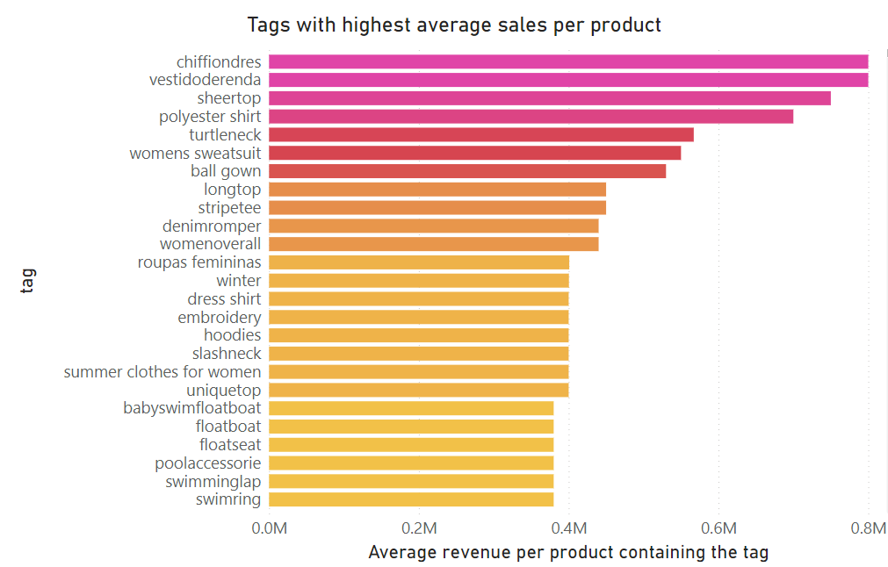
05
Top performing categories in sales
Visualize total sales volume over time (if time data available) or by product category.
Highlight top-performing categories and any noticeable trends.
It appears that products using ad boosting actually have lower average units sold and revenue as compared to those without ad boosting. This can be a surprising finding, but there are two possible explanations

Slide 8
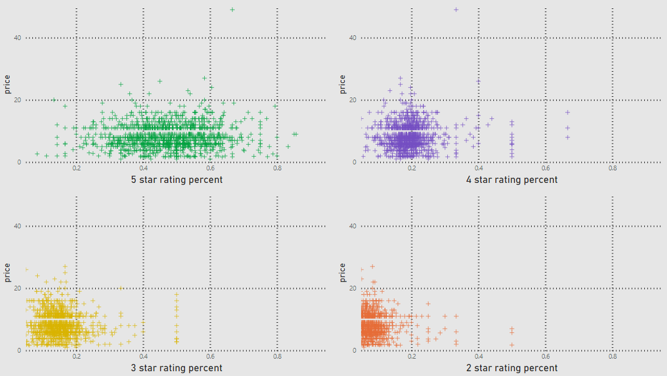
06
Ratings and price factor analysis
Chart showing the distribution of product prices vs. retail prices.
Insights into how pricing affects sales volume, including any patterns related to discounts or price sensitivity.

Slide 9
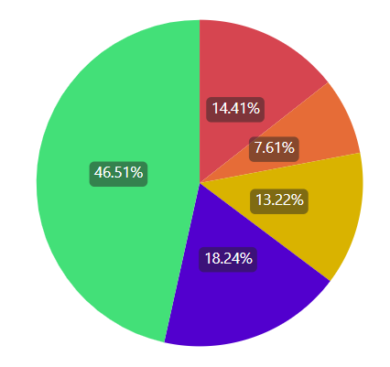
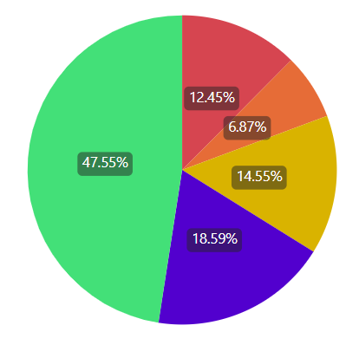
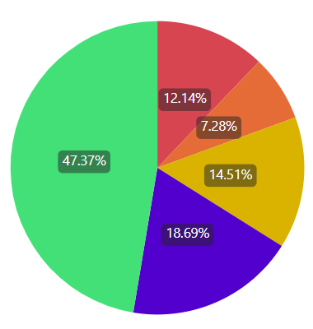
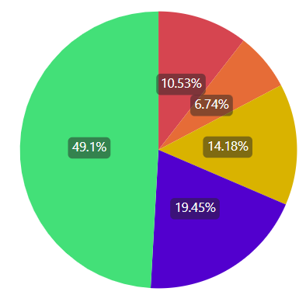
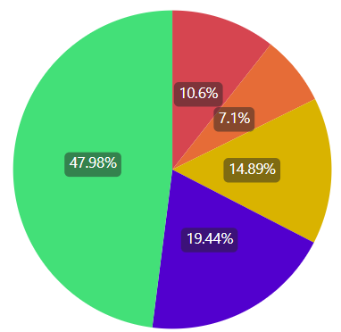
07
Ratings and units sold analysis
The products are divided into 5 groups by a range of units being sold
For each group of categorized products by units sold, we can estimate the average percent of star ratings, ranging from 1 star to 5 star rating.
It appears that the distribution of percent of star rating is similar across all units sold.
However, on average, the percent of 4 and 5 star ratings become slightly higher if the products are sold more often ⇒ 💡 INSIGHT: existing good ratings of a product can indeed boost its sales performance
1 – 100
units sold
101 – 1000
units sold
1001-5000
units sold
5001 – 10000
units sold
10001 – 100000
units sold

Slide 10
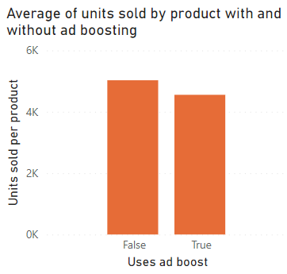
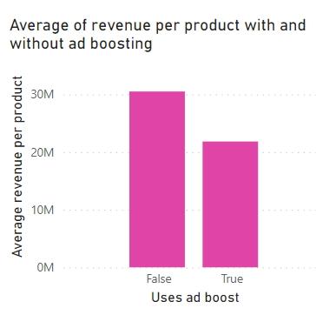
08
Impact of Ad Boosts on sales
It appears that products using ad boosting actually have lower average units sold and revenue as compared to those without ad boosting. This can be surprising, but there are two possible explanations
Products that rely heavily on ad boosts might have less appeal or weaker product-market fit compared to others that sell well without additional advertising.
The online shopping market can be saturated with similar ads about summer products, potential customers might experience ad fatigue. This lead to diminishing returns on further advertising
⇒ ✊ ACTION: It is okay for products to not use ad boosting at all, which could help cut advertising costs.

Slide 11
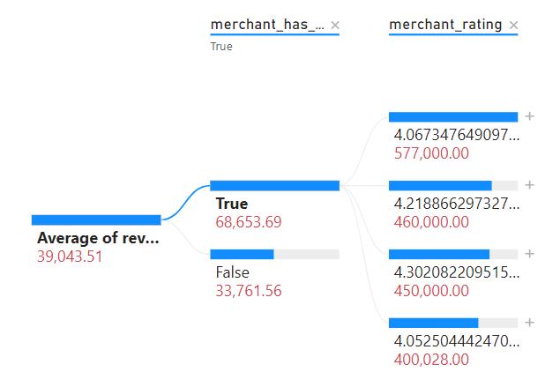
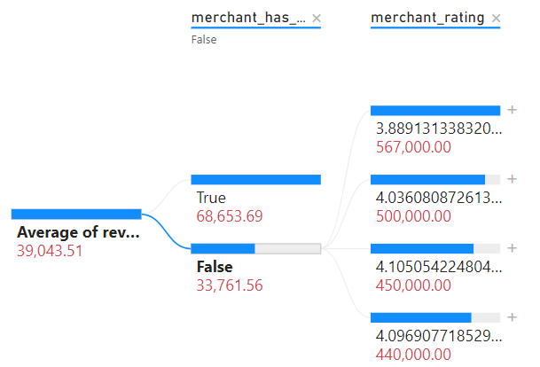
09
Merchant performance insights
Top merchants rating (black) with profile picture and their revenue (red)
Top merchants rating (black) with profile picture and their revenue (red)
merchant having profile picture or not
merchant having profile picture or not
Average revenue
Average revenue

Slide 12
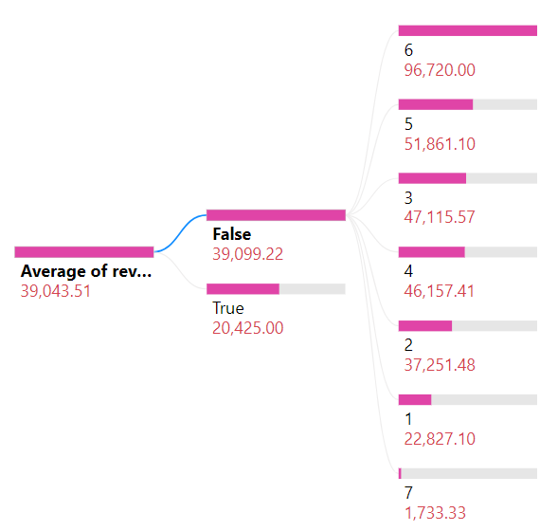
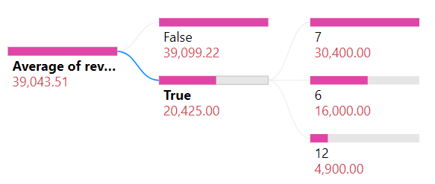
10
Shipping options and sales impact
Shipping price
Shipping is express
Shipping is express
Shipping price
Average revenue
Average revenue
Analysis of how different shipping options (including express shipping availability) affect sales volumes.
Highlight preferences and trends related to shipping.

Slide 13
11
Banner & urgency status on sales impact
Explore the presence of an urgency banner (e.g., limited stock) on product listings and its impact on sales.
Provide insights into consumer behavior related to urgency in purchasing.

Slide 14
12
Human sensitiveness to price drops
How about trying to validate the established idea of human sensitiveness to price drops ? (discounted price compared to original retail_price)

Slide 15

Conclusion and Appendix

Slide 16
This dataset contains product listings as well as sales performance, which you would not find in other datasets. With this, you can finally start to look for correlations and patterns regarding the success of a product and the various components.
The index, crawl_month, product_picture, product_url, merchant_profile_picture columns are dropped since they are not relevant to the analysis
Currency_buyer and theme columns are deleted because they have only 1 value (EUR and Summer respectively), which gives no insights into the dataset. Shipping_option_name, urgency_text, origin_country also removed from analysis as most products have the same shipping option and urgency message (quantity limited) and origin country (China)
Uses_ad_boosts, badge_local_product, badge_product_quality, badge_fast_shipping, shipping_is_express, has_urgency_banner, merchant_has_profile_picture is turned into True/False datatype instead of 0 and 1
Merchant name and merchant title are nearly similar. Additionally, since there are no two merchants of different id that have the same title, the merchant title is unique. We can remove the columns merchant_id and merchant_name
Additionally, title_orig is also unique for product_id, so we can also remove the product_id and title columns
merchant_positive_review_percent is added to the dataset, derived from the merchant_info_subtitle column
Tags column generate 3 columns: tags_count, popular_tags_count and unpopular_tags_count. Popularity is determined by how often the tag occurs in all products in the dataset. If a tag occurs in at least 10 products, it is popular tag, otherwise it is unpopular

Slide 17
DESCRIPTION
See top products and hack the reason behind their success. This dataset contains sales performance, unlike many others.
SUMMARY
Summer Products and all related metrics data
Foreword
This users dataset is a preview of a much bigger dataset, with lots of related data (product listings of sellers, reviews on listed products, etc...).
Context
Studying top products requires more than just product listings. You also need to know what sells well and what does not.
Content
This dataset contains product listings as well as sales performance, which you would not find in other datasets. With this, you can finally start to look for correlations and patterns regarding the success of a product and the various components.

Slide 18
Inspiration
How about trying to validate the established idea of human sensitiveness to price drops ? (discounted price compared to original retail_price)
You may look for top categories of products so that you know what sells best
Do bad products sell ? How about the relationship between the quality of a product (ratings) and its success ? Does the price factor into this ?
Collection Methodology
- The data comes from the Wish platform.
- You can browse it to get a feel of the type of information you can get from there and how they are presented. This might give you some ideas and a better understanding.
- If you are confused about some columns, you can either browse the Wish website or app, or you can ask in the comments.
- The data was scraped in the french localisation (hence some non-ascii latin characters such as « é » and « à ») in the title column.
- Here is an example of an english search results page. Remember that the products found in this dataset are those from a French search results page.

Slide 19
Example Business Task
- Re-stocking products with the best potential is crucial for shops and businesses around the world.
- Through this dataset and task, you are requested to build a model that can help predict how well a product is going to sell.
- Such a model has many implications and could be used in many different ways, the most straightforward being to adjust how much of a product should be kept in stock.
This would allow you to better understand e-commerce sales and get you a certain expertise for helping businesses optimize their stocks and sales.

Slide 20
Inspiration
- How about trying to validate the established idea of human sensitiveness to price drops ?
- You may look for top categories of products so that you know what sells best
- Do bad products sell ? How about the relationship between the quality of a product (ratings) and its success ? Does the price factor into this ?
- Do seller's fame factor into top products ?
- Do the number of tags (making a product more discoverable) factor into the success of a product ?
Expected Submission
- What should users submit? Should they solve the task primarily using Notebooks or Datasets? What should the solution contain? You may solve this task using a notebook.
Evaluation: What makes a good solution?
Your solution should minimize the risks of:
- Buying way too much of a product
- Ideally, identify products with a higher discount regarding the retail price. Practically, this means identifying products where the seller could increase his profit margin without losing too many buyers. See the concept of Price Elasticity of the demande
- Lastly. There are always a lot of product opportunities, so missing on a single opportunity is better than buying way too much another product, since this might cancel out the profits gained elsewhere.
Your model will be evaluated on another similar dataset (same features and columns) to see how well it performs on new other data.

Slide 21
Choose an Experience
Adventure
Enthusiasm
Discovery

Slide 22
Travel Budget

Slide 23

Transportation
Car
Ride Share
Taxi
Rental
Air
Int.
Domestic
Rail
Railway

Slide 24

Thank You
someone@example.com

